Slide 1
Network FUNDAMENTALS for developers
Understanding networking AND options

Slide 2
Ideas:
NSEW network traffic model
Azure
VNet (CIDR, Subnetting)
ALB (Layer 4)
Firewall
FrontDoor (Layer 7, SSL offloading, URL)
Traffic Manager (DNS based routing)
Network Security Group (stateful)
App Gateway (Layer 7)
Route table
VPN
AWS
VPC (public/private subnets)
NLB/ALB
Firewall
Security Groups (stateful)
NACL (stateless)
VPN
Endpoint Services
Additional ideas
OSI Model
IDS & IDP
Common ports
Web traffic

Slide 3
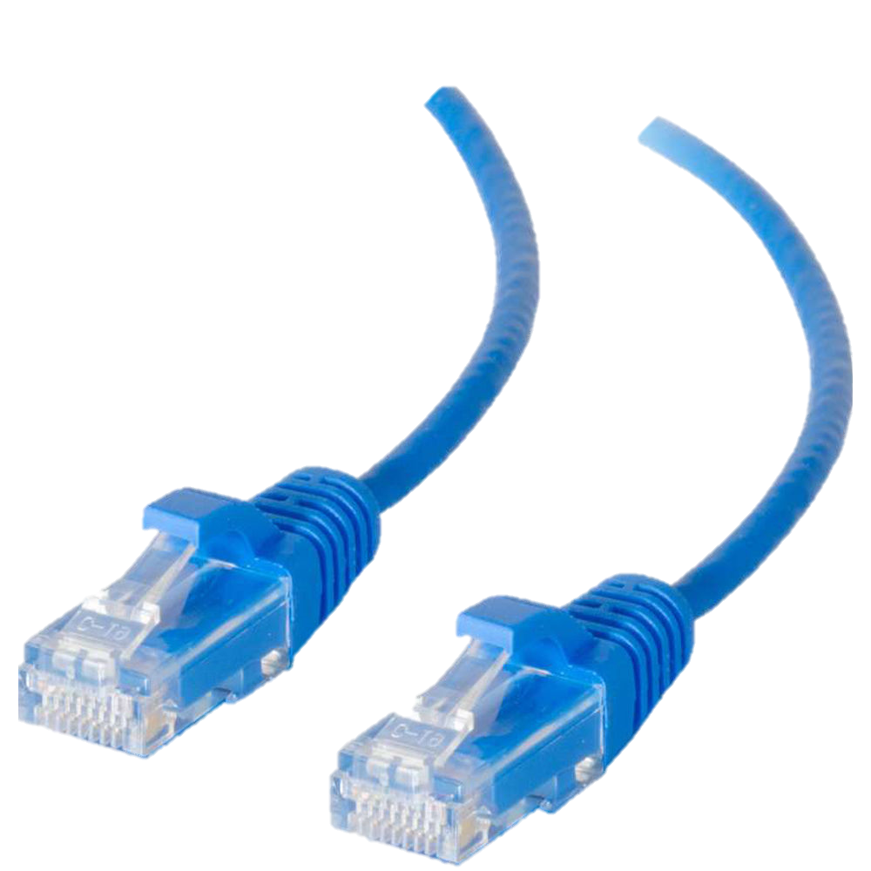
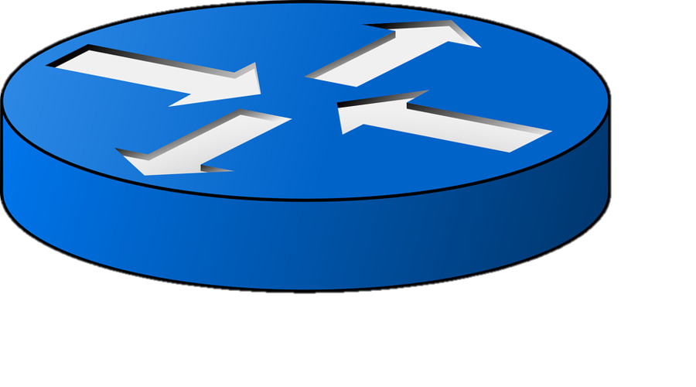

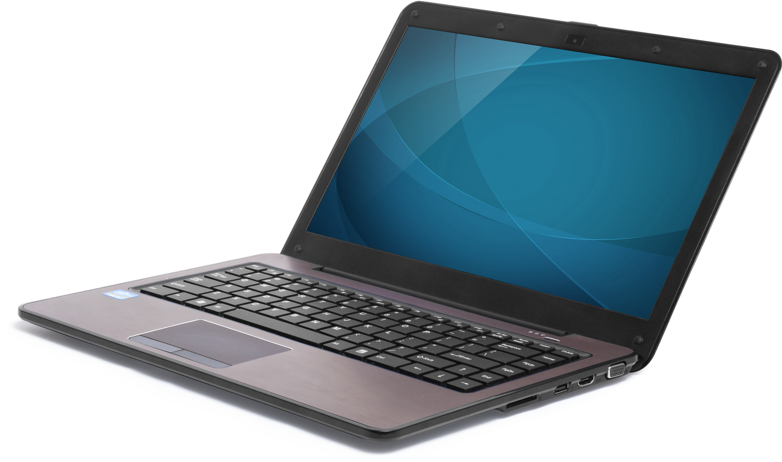
Basics

Slide 4
Home Network

Slide 5

Home Network

Slide 6


Home Network

Slide 7
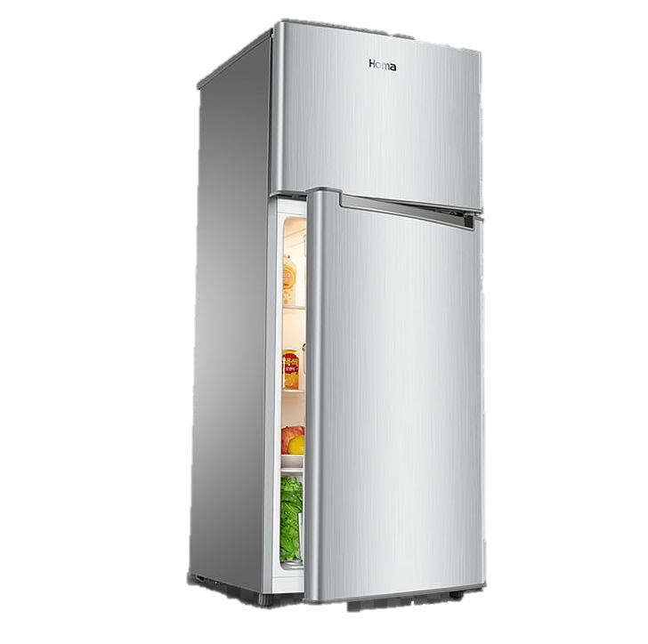
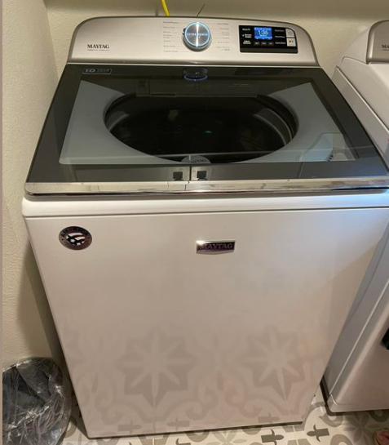
Home Network

Slide 8
Home to Internet
Internet
Home Devices

Slide 9
Home to Internet
Internet
WAN
Wide Area Network
LAN
Local Area Network
Home Devices

Slide 10
Home to Internet
Internet
Website
WAN
Wide Area Network
LAN
Local Area Network
Home Devices

Slide 11
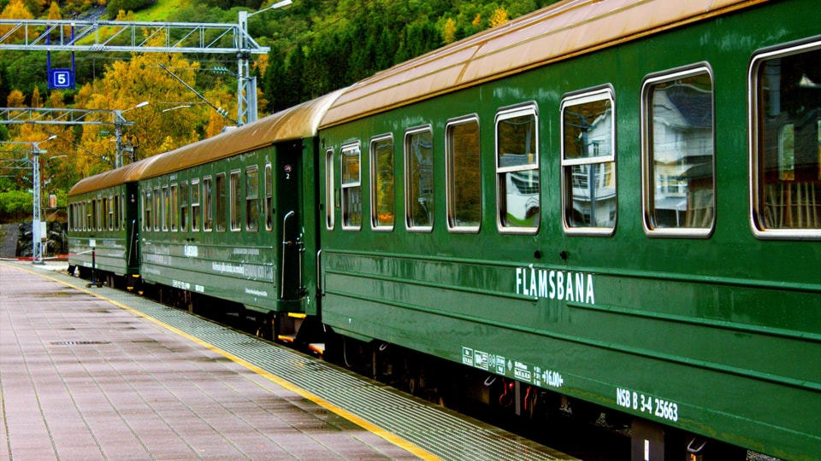
Packets

Slide 12
DNS
DNS == Domain Name Service
DNS === Domain Name Service
Javascript friendly 😂
Ipconfig /displaydns
Ipconfig /flushdns

Slide 13

DNS
Chad Green

Slide 14
DNS
Chad Green
1-900-555-1212
(not real number)

Slide 15
DNS
A – Name to IP
CNAME – Alias
MX – Mail Exchange

Slide 16
DNS
nslookup
set type=NS
set type=MX
set type=CNAME
set type=AAAA (IPv6)

Slide 17
DNS
https://usergroup.tv
nslookup usergroup.tv
Addresses: 185.199.108.153
185.199.109.153
185.199.110.153
184.199.111.153

Slide 18

Routing
Chad Green

Slide 19
Routing
Chad Green
Chad Green
123 Any Street
Louisville, KY 40245
Notes:
I’m not sending from my zip code.

Slide 20
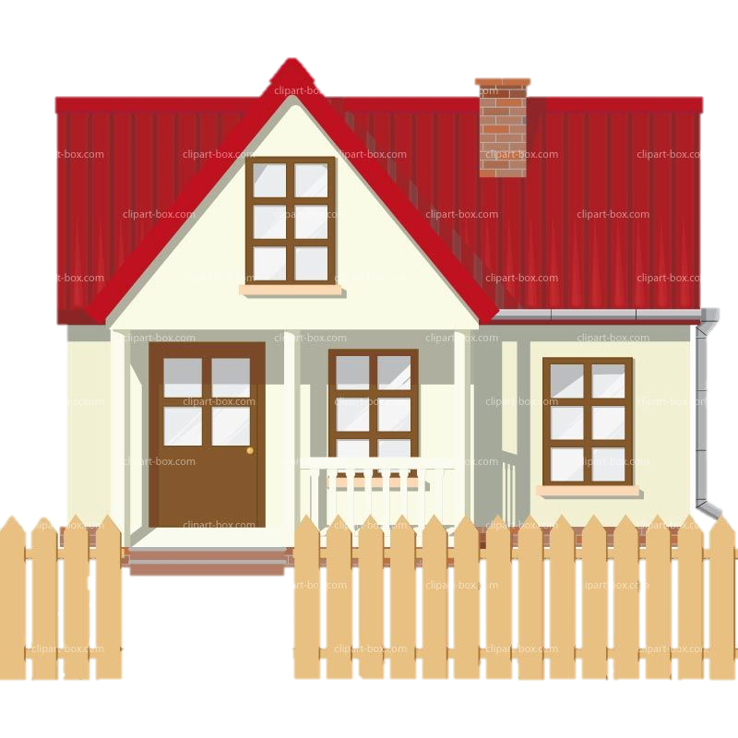
Routing
1. 40245
2. Any Street
3. 123
- Chad Green

Slide 21
IPv4
IP == Internet Protocol
4 Octets
Each octet goes 0 to 255
Binary
192.168.0.10

Slide 22
IPv4
192.168.0.10
1100 0000
1010 1000
0000 0000
0000 1010
32 bits

Slide 23
IPv4
192.168.0.10
1100 0000
1010 1000
0000 0000
0000 1010
1111 1111
1111 1111
1111 1111
0000 0000
255.255.255.0

Slide 24
IPv4
192.168.0.10
IP Address
1100 0000
1010 1000
0000 0000
0000 1010
1111 1111
1111 1111
1111 1111
0000 0000
255.255.255.0
Subnet Mask

Slide 25
IPv4
192.168.0.10
Network
Host
1100 0000
1010 1000
0000 0000
0000 1010
1111 1111
1111 1111
1111 1111
0000 0000
255.255.255.0

Slide 26
IPv4
192.168.0.10
Network
Host
1100 0000
1010 1000
0000 0000
0000 1010
1111 1111
1111 1111
1111 1110
0000 0000
255.255.254.0

Slide 27
IPv4
Class | Range | # of Networks | # Available Address
A | 0.0.0.0 - 127.255.255.255 | 128 | 16,777,216
B | 128.0.0.0 - 191.255.255.255 | 16,384 | 1,048,576
C | 192.0.0.0 - 223.255.255.255 | 2,097,152 | 65,536
There are total of 5 classes.

Slide 28
IPv4 Private Addresses
RFC 1918 – Non-Routable Addresses
Network | CIDR Notation | Starting Range | # Available Address
10 | 10/8 | 10.0.0.0 | 16,777,216
172 | 172.16/12 | 172.16.0.0 | 1,048,576
192 | 192.168/16 | 192.168.0.0 | 65,536

Slide 29
Network Sizing
?
How big of a network do you need?
How many IP addresses do you need?

Slide 30
Network Sizing
10.0.0.0/24
256
10.0.0.0-10.0.0.255
10.0.0.0/24

Slide 31
Network Sizing
10.0.0.0/24
256
10.0.0.0-10.0.0.255
10.0.0.0/24
192.168.0.10
Network
Host
1100 0000
1010 1000
0000 0000
0000 1010
1111 1111
1111 1111
1111 1111
0000 0000
24 bits

Slide 32
Network Sizing
10.0.0.0/23
512
10.0.0.0-10.0.1.255
10.0.0.0/23
256
10.0.0.0-10.0.0.255
10.0.0.0/24
256
10.0.1.0-10.0.1.255
10.0.1.0/24

Slide 33
Network Sizing
10.0.0.0/24
128
10.0.0.0-10.0.0.127
10.0.0.0/25
128
10.0.0.128-10.0.0.255
10.0.0.0/25

Slide 34
Network Sizing
10.0.0.0/23
128
10.0.0.0-10.0.0.127
10.0.0.0/25
128
10.0.0.128-10.0.0.255
10.0.0.128/25
64
10.0.1.0-10.0.1.63
10.0.1.0/26
64
10.0.1.64-10.0.1.127
10.0.1.64/26
64
10.0.1.128-10.0.1.191
10.0.1.128/26
64
10.0.1.192-10.0.1.255
10.0.1.192/26

Slide 35
Network Sizing
10.0.0.0/25
32
10.0.0.0-10.0.0.31
10.0.0.0/27
32
10.0.0.32-10.0.0.63
10.0.0.32/27
32
10.0.0.64-10.0.0.95
10.0.0.64/27
32
10.0.0.96-10.0.0.127
10.0.0.96/27

Slide 36
Network Sizing
10.0.0.0/25
32
10.0.0.0-10.0.0.31
10.0.0.0/27
DMZ
32
10.0.0.32-10.0.0.63
10.0.0.32/27
Web
32
10.0.0.64-10.0.0.95
10.0.0.64/27
App
32
10.0.0.96-10.0.0.127
10.0.0.96/27
DB

Slide 37
IPv4 CIDR
CIDR = Classless Inter-Domain Routing
CIDR | # of IPs | Example Range
24 | 256 | 10.0.0.0 – 10.0.0.255
25 | 128 | 10.0.0.0 – 10.0.0.127
26 | 64 | 10.0.0.0 – 10.0.0.63
27 | 32 | 10.0.0.0 – 10.0.0.31
28 | 16 | 10.0.0.0 – 10.0.0.15
29 | 8 | 10.0.0.0 – 10.0.0.7
30* | 4 | 10.0.0.0 – 10.0.0.3
31 | 2 | Not Possible
32 | Most specific | 10.0.0.10
* Not available in clouds

Slide 38

Network Address Translation
Internet
Website Server

Slide 39
Network Address Translation
Internet
Website Server
192.168.0.5

Slide 40
Network Address Translation
Internet
40.134.210.98
Website Server
192.168.0.5
whatismyipaddress.com

Slide 41
Network Address Translation
Internet
40.134.210.98
Website Server
192.168.0.5
whatismyipaddress.com
Network Address Translation

Slide 42
Network Address Translation
Internet
40.134.210.98
192.168.0.6
192.168.0.5
Network Address Translation

Slide 43
Port Address Translation
Internet
40.134.210.98
192.168.0.6
192.168.0.5

Slide 44
Port Address Translation
Internet
40.134.210.98 : 45123
192.168.0.6
192.168.0.5
Ports – 0 thru 65535
Reserved Ports – 0 thru 1023

Slide 45
Port Address Translation
Internet
40.134.210.98 : 45123
40.134.210.98 : 45124
192.168.0.6
192.168.0.5
Ports – 0 thru 65535
Reserved Ports – 0 thru 1023
Notes:
Risk port exhaustion

Slide 46
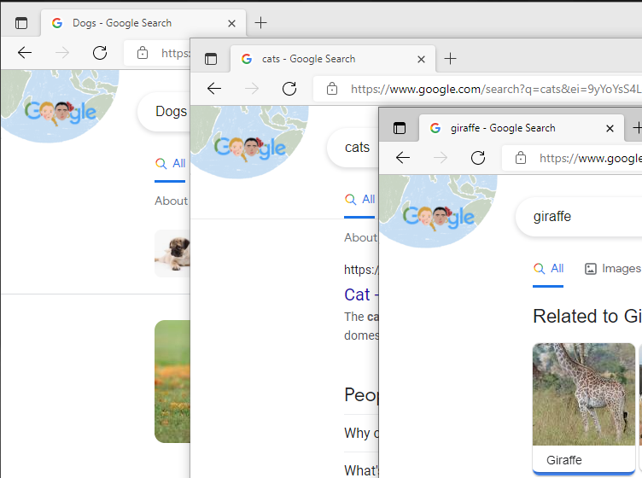
Port Address Translation

Slide 47
Common Ports
20 & 21 | FTP
22 | SSH
25 | SMTP
53 | DNS
80 & 443 | Web and SSL/TLS | HTTP & HTTPS
1443 | SQL Server
Notes:
IDS/IPS protocol inspection

Slide 48
OSI Model
Open System Interconnect Model
7 | Application | HTTP | Azure App Gateway, AWS ALB, Nginx
6 | Presentation | SSL
5 | Session
4 | Transport | TCP vs UDP | Azure LB, AWS NLB
3 | Network | IP
2 | Data
1 | Physical
Notes:
Transport Control Protocol – User Datagram Protocol
All People Seem To Need Data Processing – anagram

Slide 49
Why Does This Matter ?
Why Does This Matter?

Slide 50
Why Does This Matter ?
Security
Splitting Resource Needs
Understanding Architecture
Shift Left
Career Growth

Slide 51


North-South East-West – Security Model
Internet
VM/ EC2 / Container
DMZ
App Server Layer
Database Layer
Notes:
Can restrict IP, or Port, or Protocol

Slide 52
Azure -- VNet → Virtual Network

Slide 53
Azure -- VNet → Virtual Network
Subnet | Range | Route Table | Type
1 | 192.168.0.0/24 | A | Public
2 | 192.168.1.0/24 | B | Private
Route Table
A
 | 192.168.0.0/24
 | 0.0.0.0/0 | Forward traffic to Firewall
B
 | 192.168.1.0/24
*Traffic allowed between subnets when there is no route table
** https://docs.microsoft.com/en-us/azure/virtual-network/virtual-networks-udr-overview

Slide 54
AWS – VPC → Virtual Private Cloud

Slide 55
AWS – VPC → Virtual Private Cloud
Subnet | Range | Route Table | Type
1 | 192.168.0.0/24 | A | Public
2 | 192.168.1.0/24 | B | Private
Route Table
A
 | 192.168.0.0/24
 | IGW (Internet Gateway)
B
 | 192.168.1.0/24

Slide 56
Route Tables
What is the purpose of a route table?
What is routing? Next hop?

Slide 57
Route Tables
What is the purpose of a route table?
What is routing? Next hop?
Control traffic from detail paths
Security

Slide 58
Load Balancers
Application
Instances not
Necessarily servers
What load balancing needs do we have?

Slide 59
Load Balancers
Application
Instances not
Necessarily servers
What load balancing needs do we have?
Layer 4 ? Azure Load Balancer; AWS Network Load Balancer

Slide 60
Load Balancers
Application
Instances not
Necessarily servers
What load balancing needs do we have?
Layer 4 ? Azure Load Balancer; AWS Network Load Balancer
Layer 7 ? Azure App Gateway; AWS App Load Balancer

Slide 61
Security Group & NACLs
Azure
AWS
Network Security Groups
VM level
Stateful
Security Groups
EC2 level
Stateful
NACL
Network Access Control List
Stateless, one rule does not
allow both directions

Slide 62
?

Slide 63
Who am I ?
Sean Whitesell
Cloud Architect
Microsoft MVP
User Group Leader in Tulsa
@codewithseanw
seanwhitesell.com
twitch.tv/codewithsean

